Slide 1
Trends of Crime in the USA
By Daniel Jin

Slide 2
Introduction
Crime is something that is unpredictable when it happens and once it happens, it is too late. Predicting the exact time or type of crime committed is impossible, but what if we can determine if crime is more likely to happen under certain conditions?
If it was found that after major disasters, crime rate increases, law enforcement would know to be on high alert to reduce those crimes.
An interactive visualization application will be created to help with exploratory data analysis and then a statistical model will be built to find what contributes to the number of crimes committed

Slide 3
Datasets
A variety of government data is used. They are all aggregated by year and state
Crime (Counts of various crimes: rape, homicide, theft, etc)
Weather (temperature, standard precipitation index, various weather events such as hurricanes)
Population (population, race, sex, and age)
Income
Gas Prices
Health (Mental and physical health)

Slide 4
Data Cleaning
Cleaning included
Fixing data types
Fixed variables so they are only stored in one column
Split columns with multiple variables stored in them to separate columns
Fixed values inside a few columns. I.e. converted 10k to 10000.
Computed dollars per gallon for Gas data. Original was in dollars per million british thermal units
Removed/replaced invalid values.
Joined all the data by year and state

Slide 5
Visualization Application using Dash
The application can be found at: https://finding-crime-trends.herokuapp.com/
Features:
Each crime can be removed or added to total crimes
Select variables to plot time series or against total crimes committed. Includes two for easy comparison for against each other
Select states to include
Select year range to include
Overall time series is displayed to see total crimes committed over time
Table filter at the bottom to further filter variables in other ways
Average or Sum option provided for the time series to change data interpretation

Slide 6
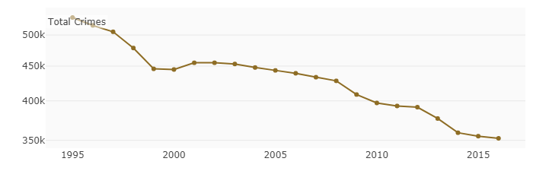
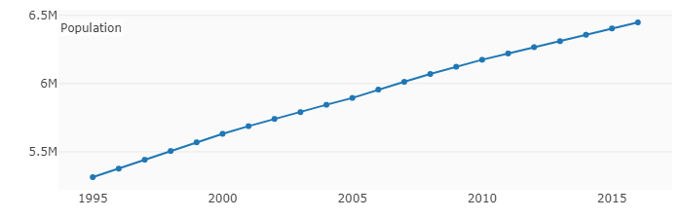
Example Usage
The average number of crimes committed from 1995 to 2016 decreases despite the overall average population of the USA increasing

Slide 7
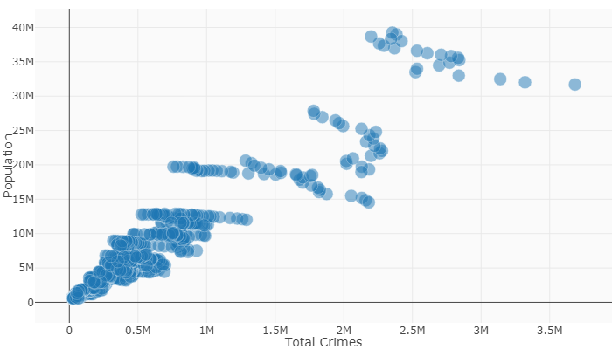
Example Usage
It appears that higher population results in higher crime count (all states and years included)

Slide 8
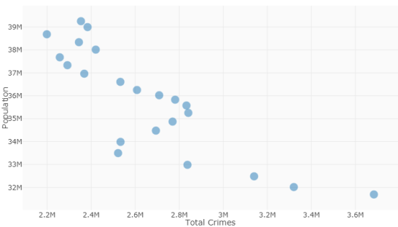
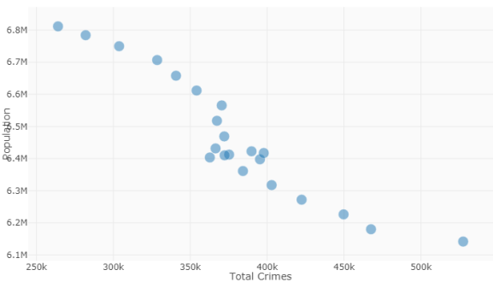
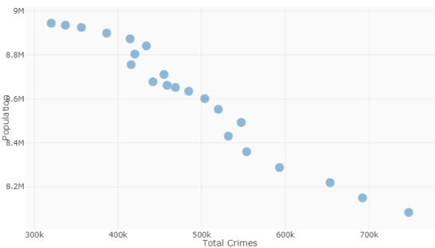
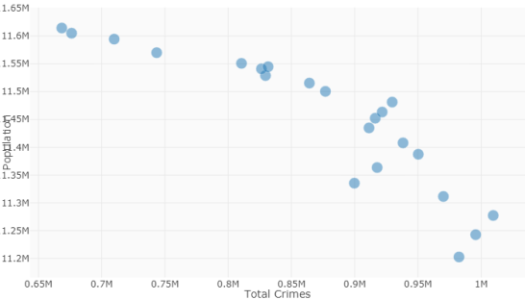
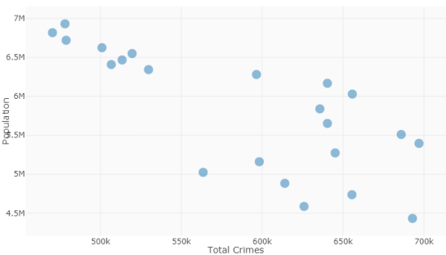
Example Usage
The effects of the last plot were due to Simpson’s paradox. Looking at the states individually show a different story. There is a negative correlation between population and total crimes committed. Other factors such as population density, differing state laws, methods of recording crime count, time, etc could potentially be confounding the relationship. Since population has a gradual increase over the years, law enforcement may have improved over time to prevent times.

Slide 9
Statistical Modeling
A negative binomial model is chosen because we have count data. It is theoretically chosen over Poisson because we can’t have negative count
I perform regression with a general linear model with a log link function
log μ = β0 + β1x1 + β2x2 + … where μ is the expected count of the response. Total number of crimes committed in this case

Slide 10
Model Selection
First, insignificant variables are the univariate level were dropped
I performed forward selection using a lower AIC as the criteria to select the model
The model ended with State, DEATHS_DIRECT, Gas_Per_Gallon, SPI, Population, and Year as the predictors

Slide 11
Checking Assumptions
The negative binomial model assumes the conditional means are not equal to the conditional variances.
We test this by comparing with the Poisson model, since the dispersion parameter is held constant in it
Using a log likelihood ratio test, the negative binomial model is strongly favored

Slide 12
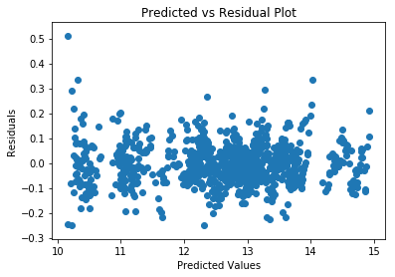
Checking Assumptions
Total_Crimes should depend linearly on the predictors. Since we have a log link function, a log is casted over the fitted values
Since there are no curvature and the
residuals look flat positioned around 0,
This assumption is satisfied.

Slide 13
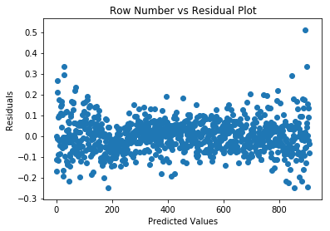
Checking Assumptions
The residuals should not depend on the row number of the data frame
Since there are no curvature and the
residuals look flat positioned around 0,
This assumption is satisfied.

Slide 14
Multicollinearity
Checking the variation inflation factors, Population is concerning. It has a very high VIF value which I suspect is because of correlations with State
After running univariate tests with State and Population, I find that State is more useful in predicting the total number of crimes committed. I remove Population from the data frame

Slide 15
Final Checks
I also find two of the predictors in the model have a fairly high p value (SPI and DEATHS_DIRECT)
I remove them and check to see if the AIC value was reduced
Removing both of them results in lower AIC
The final model only has State, Gas_Per_Gallon and Year as predictors

Slide 16
Limitations
Our model is not good for predictions
Only forward selection with lower AIC was used as the criteria. There may be a better model with a different selection criteria

Slide 17
Conclusion
State, Gas_Per_Gallon, and Year are the only good predictors
These don’t tell us anything new
Since these are highly correlated with state, population, year, and gas_per_gallon, it is unclear which variables are responsible for the increase in totel crimes committed.
More research needs to be done to find more meaningful conclusions

Slide 18
Future work
Using current data:
Try other model selection methods
Model each crime type as a count in a multivariate model
Use a proportion of crimes committed relative to population size instead of a count
Try a multivariate time series model
Collect new data to merge with the current data on state and year.
May need certain government clearances or other types of clearances to obtain

